Slide 1
NE 795: Advanced Reactor Materials
Fall 2023
Dr. Benjamin Beeler

Slide 2
Last Time
Excess fluorine generated due to fission, yielding oxidizing conditions
Fission products take different forms (gaseous, precipitates, soluble salts)
Cover gas helps to remove fission products and control redox potential
UF4/UF3 ratio is an indicator of redox potential
Three principal corrosion processes: Reactions due to oxides on the metal; Reactions with dissolved impurities; Reactions with necessary constituents of the melt
Rapid initial corrosion from impurities on surface or in salt; followed by Cr-diffusion-controlled corrosion
Different materials required for different systems, depending upon irradiation, temperature, salt exposure, etc.

Slide 3
Summary
Distribution of fission products is a central safety issue, and fission products may be gaseous, solid, or dissolved
Gaseous species can be collected in the cover gas or sparge gas
The materials required fall into three main categories: (1) metallic components for primary and secondary circuits, (2) graphite (or other structural steels) in the core, and (3) materials for molten-salt fuel reprocessing systems
Primary focus on Ni-based alloys for a wide variety of salt-facing components
Graphite can be readily used and has experience in the core
Corrosion challenges change depending upon the reactor type/design
We still know relatively little about molten salts, especially regarding their fundamental thermophysical properties and their long-term corrosion behavior under irradiation

Slide 4
Need for molten salt data
The thermophysical properties of many of these salts are not well known for many of the fluoride salt systems of interest because of a lack of thermophysical property measurement data
If data are available for higher order systems, they are typically for only one (often the eutectic) or a handful of compositions of a particular system, providing little knowledge of how the thermophysical properties may change as functions of component concentrations and temperature
A primary reason for the lack of these thermophysical property data is the inherent difficulty in taking experimental measurements with fluoride salts, which tend to have high melting points, high corrosivity and reactivity with oxygen and moisture
Because of these gaps, accurate thermal modeling of molten salt reactor designs is challenging, and safety evaluations may come with too high a degree of uncertainty

Slide 5
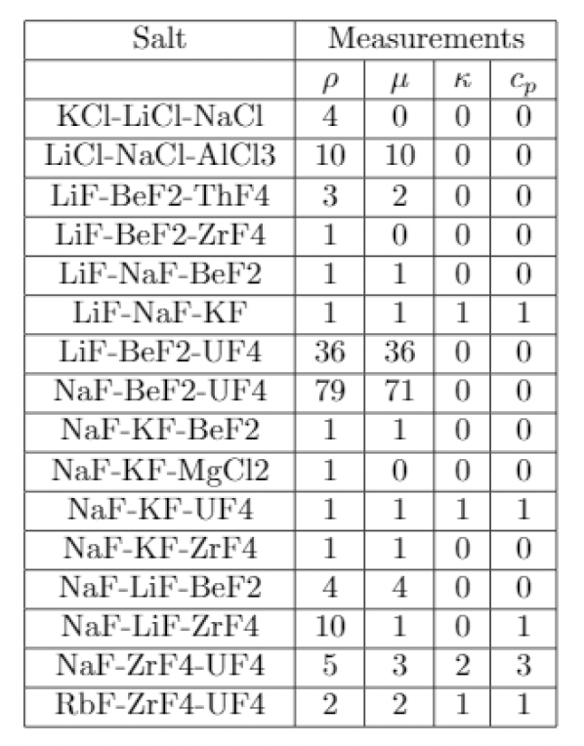
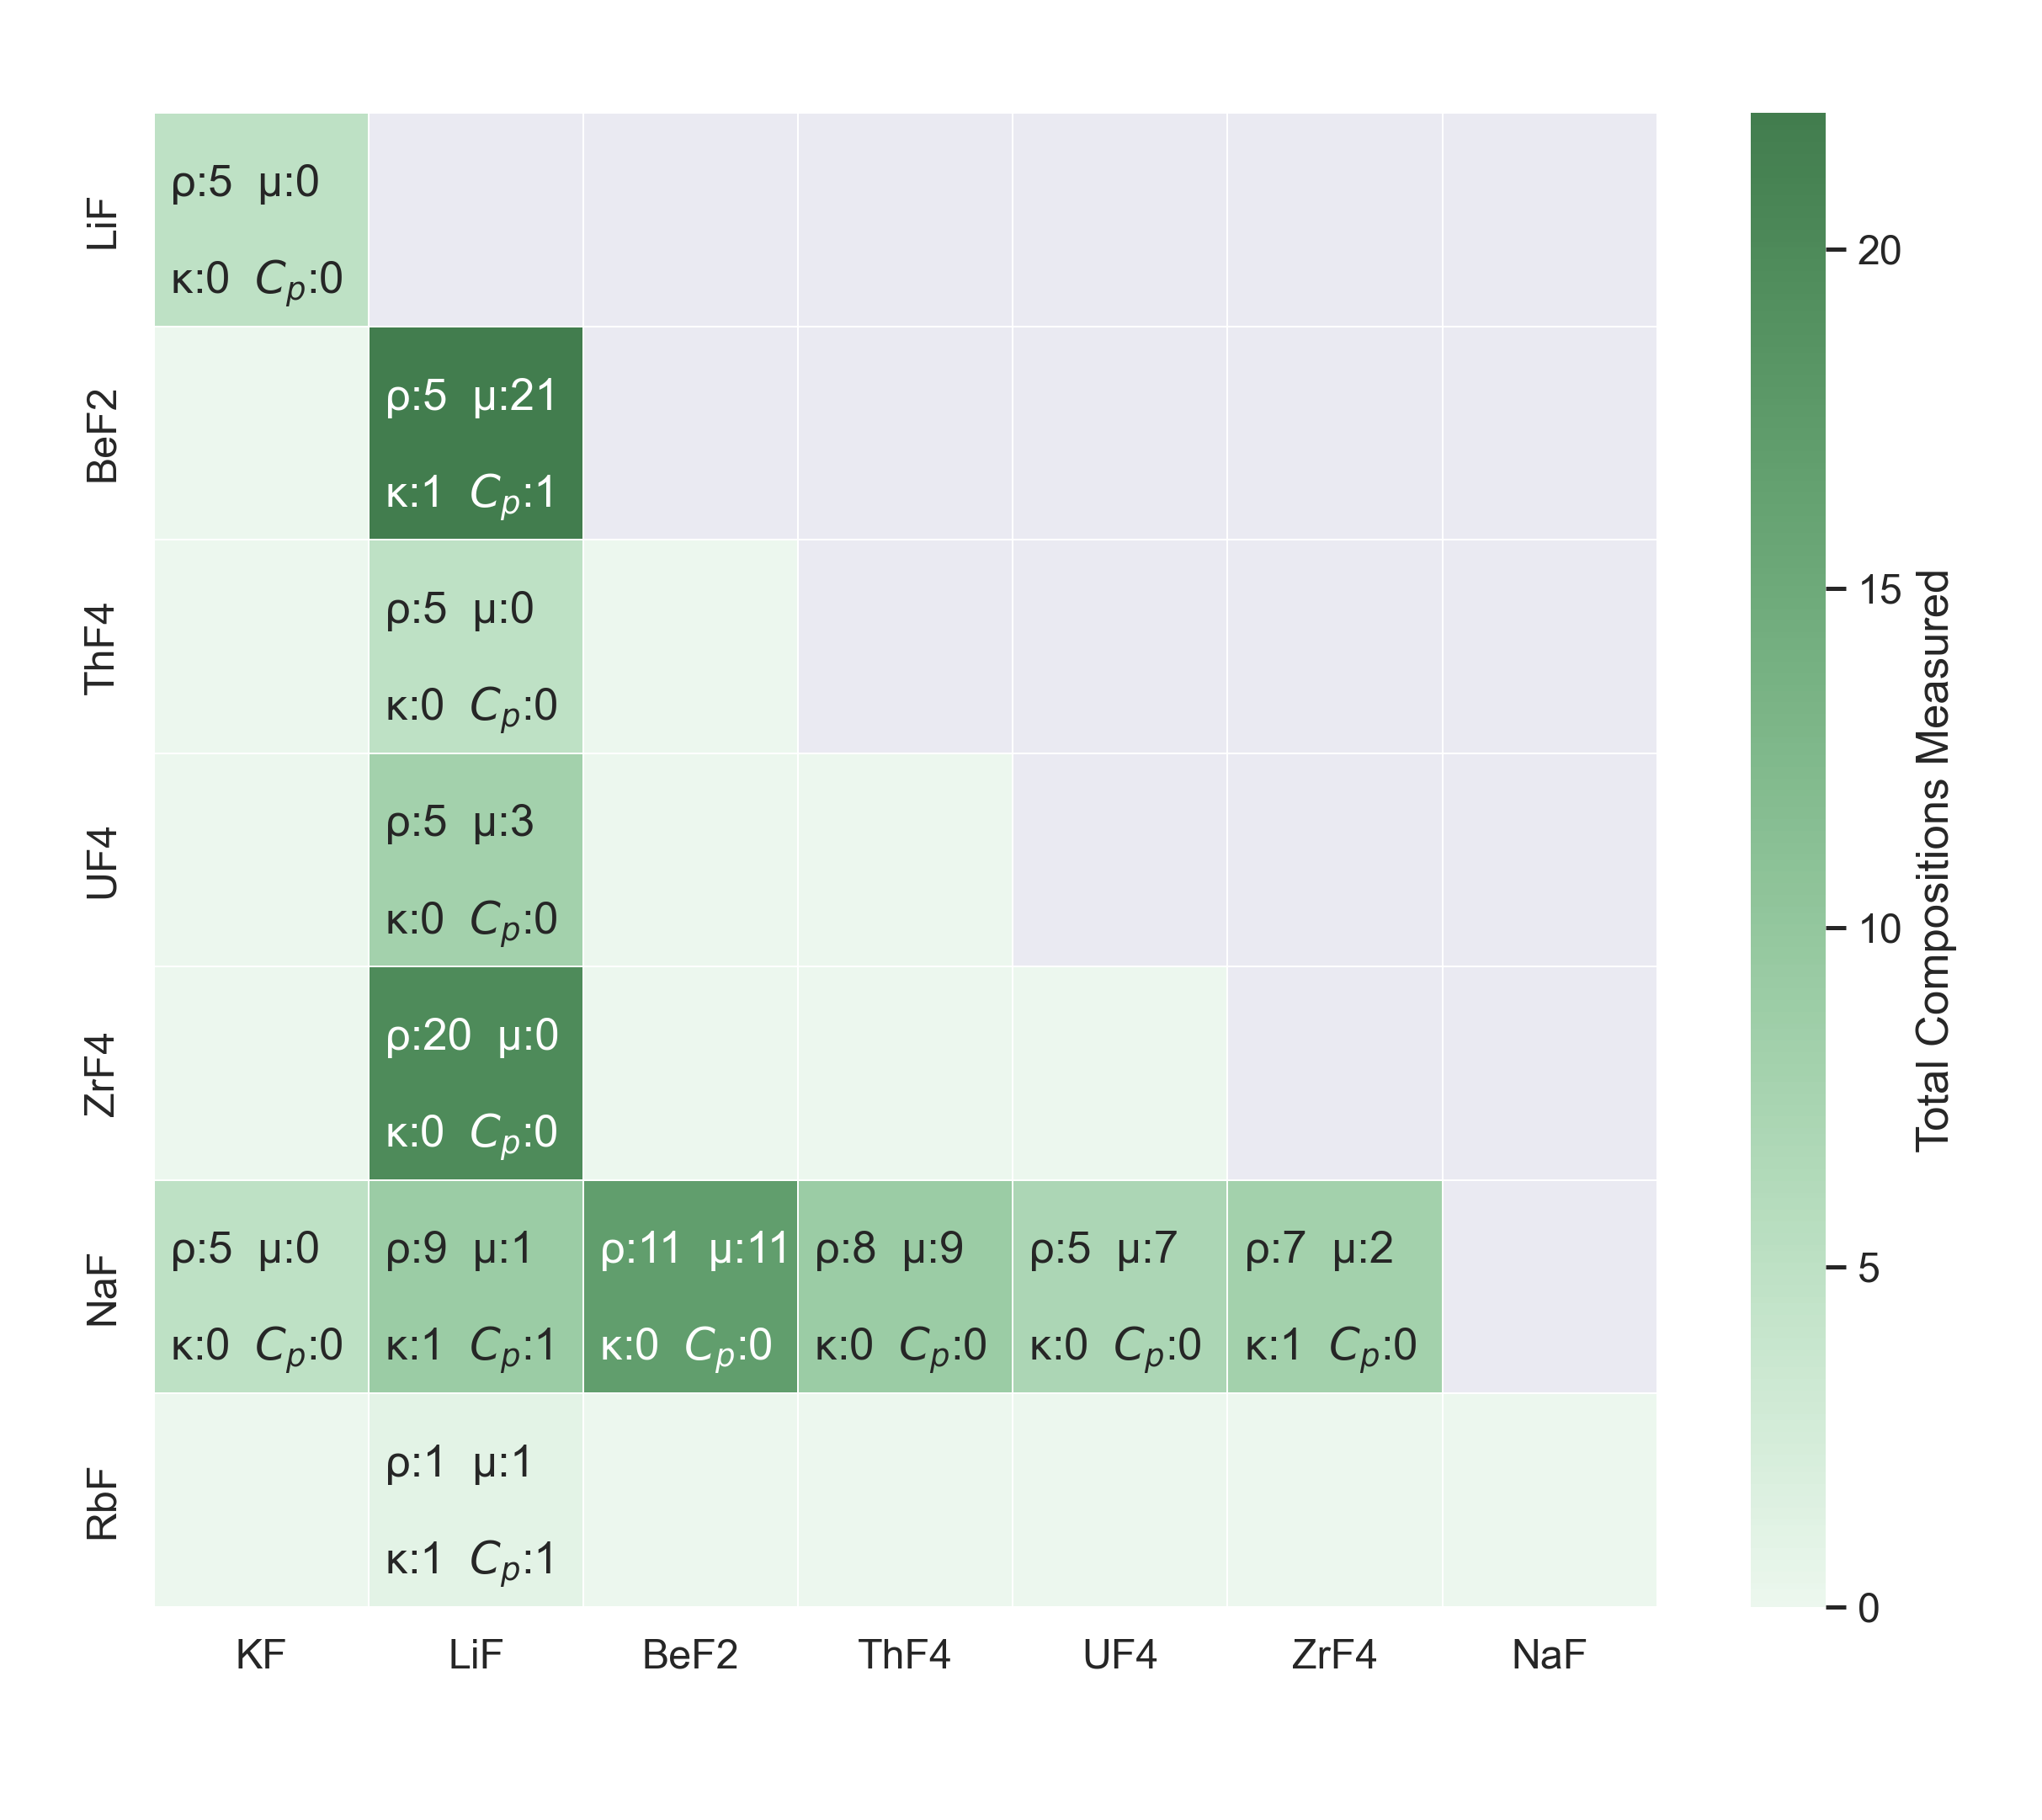
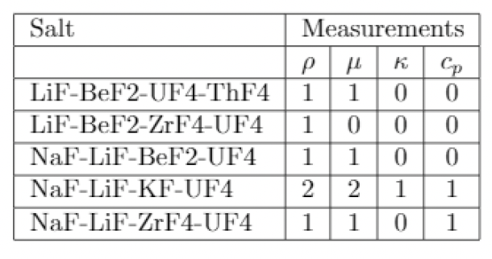
Molten Salt Thermal Properties Database
Fundamental thermodynamic salt properties are pivotal in facilitating the development of multiscale and multiphysics reactor models for molten salt reactors
The MSTDB is a collection of thermal properties of molten salts relevant to the nuclear industry
Currently includes data for: Melting and boiling point, Density, Viscosity, Thermal conductivity, and Heat capacity
The current MSTDB-TP contains data for 811 different salt compositions
There is also a MSTDB-TC which includes phase diagrams

Slide 6

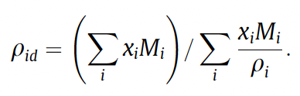
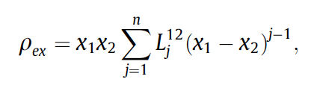

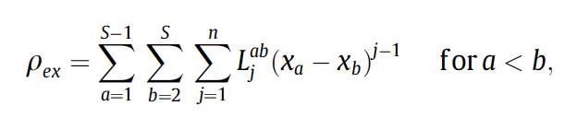
Redlich-Kister expansion
One way to increase the thermophysical understanding of these salt systems is by using estimation techniques
One method to quantify the pseudo-binary system interaction as it relates to salt density (and other properties) is use of a Redlich-Kister (RK) expansion
The choice to use an RK formalism for density estimation of molten salts has basis because excess molar volumes, which are directly related to density, have been commonly modeled using RK expansions
The RK expansion can account for deviation from ideal mixing with the addition of an excess term

Slide 7
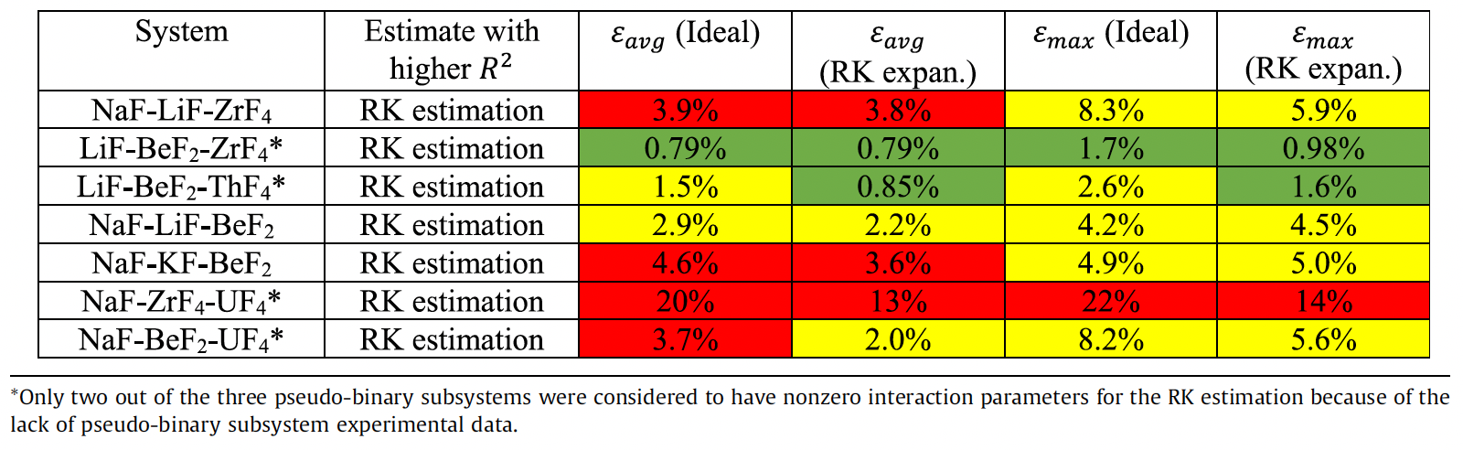
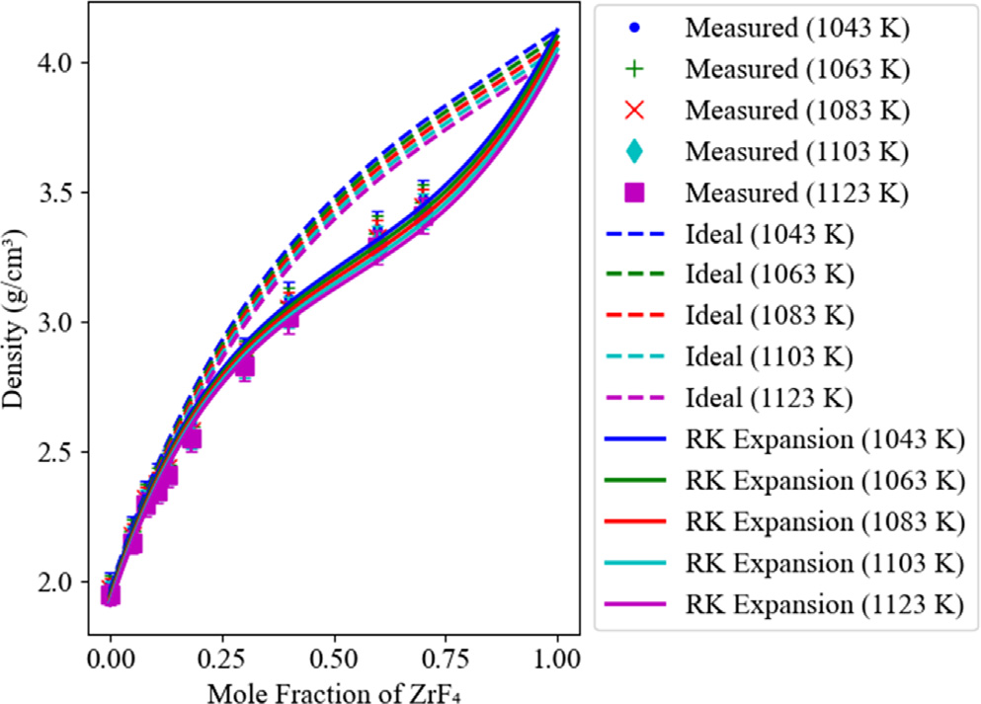
Redlich-Kister expansion
The R-K approach shows improved predictions over assuming ideal mixing for both pseudo-binary and pseudo-ternary systems
Some systems can still present large errors, and need to be investigated through experiments or modeling to supplement the knowledge base
R-K models have also been extended to heat capacity and viscosity, and show similar improvements compared to ideal mixing
Density of NaF-LiFZrF4

Slide 8
Carbides and nitrides

Slide 9
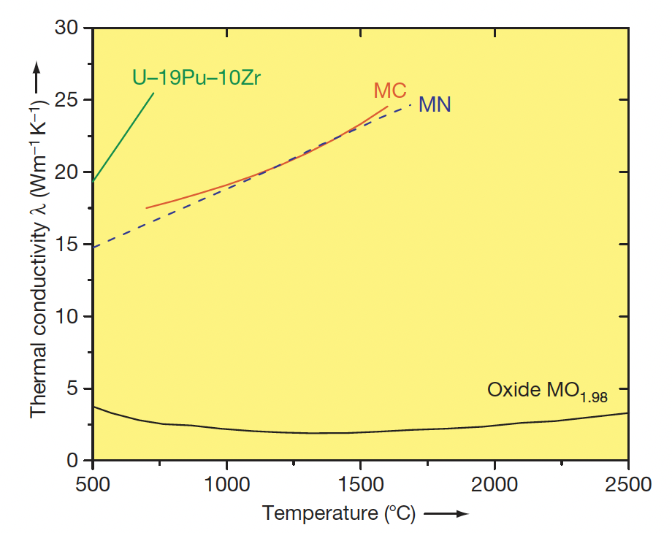
Why Carbides?
Possible fuel compositions with higher fissile atom density are non-oxide ceramics, for example, uranium–plutonium-mixed carbide or nitride
These fuels have higher thermal conductivity, high fissile heavy-atom density, and a high melting point compared to metallic fuel
The higher thermal conductivity of carbide fuel and high melting point makes carbide fuel suitable for operation at high power

Slide 10
Why Carbides?
The more efficient heat transfer also allows for the possibility of large diameter fuel pins, with more fissile material per pin, and more power generation
High-specific-power operation permits fewer pins, compared to oxide, and a more compact core, which can reduce plant costs
A large amount of development work on carbide and nitride fuels was performed from 1960 to 1970, and more than 5000 advanced fuel pins have been fabricated and irradiated
The practical difficulty of fabrication of carbide fuel hampered carbide development
The high-purity inert cover gas required for fuel fabrication was expensive and maintenance of C/M ratio was difficult

Slide 11
Carbide Reactor
The Indian FBR program started with the introduction of plutonium-rich mixed uranium–plutonium carbide as the driver fuel for a small loop-type fast breeder test reactor
The reactor became critical in the year 1985, is still in service, and it is the only reactor operating on a full core of carbide fuel
A larger reactor is being constructed in India based on this design
Carbide fuel cannot be used in LWR because of its incompatibility with the coolant
However, it can be safely used with liquid metal (Na or lead) or gas (CO2 or He) coolants in Gen-IV reactors
Carbide fuel has a breeding ratio of at least 1.30, a doubling time of 15 years or less, and a burnup limit of more than 15 at.%

Slide 12
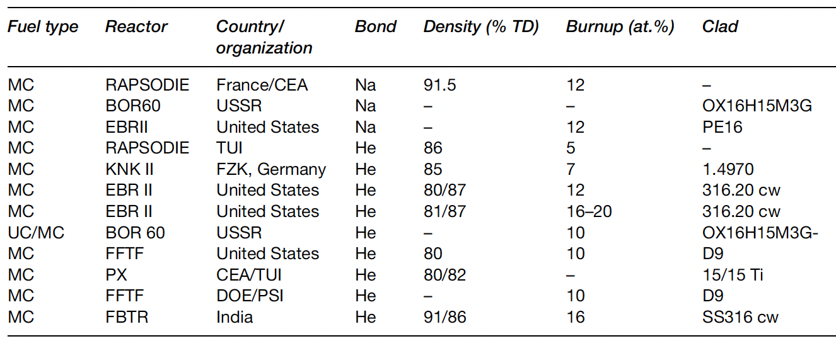
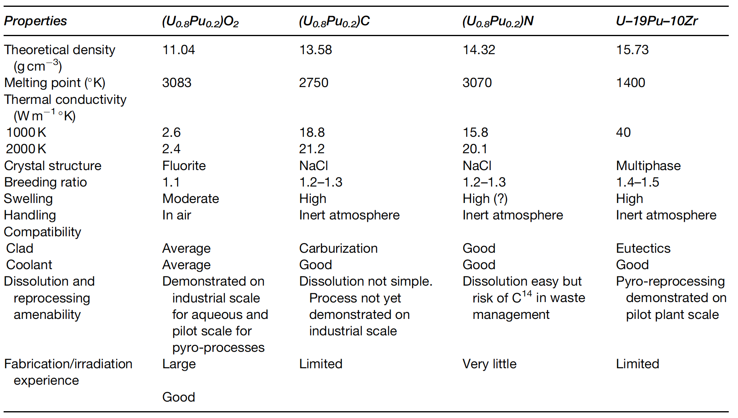
US Interest in Carbide Fuels
Many laboratories in the world were engaged in studies on the development of carbide fuels based on uranium and plutonium and thorium
After the oil crisis in 1974, a national advanced liquid-metal-cooled FBR fuels development program was initiated that built upon early years of carbide fuel development
Both carbide and nitride fuels offer a middle ground for LMFBR performance because of their higher thermal conductivity, fissile-atom density, and chemical compatibility with liquid sodium, and much higher melting point than metallic fuels

Slide 13
Carbide Pin Designs
There are two concepts available for the carbide fuel pin depending upon the type of bond between the fuel pellet and the cladding material: He-bonded and Na-bonded carbide fuels
The average operating fuel temperature of the He-bonded pin is high because of low thermal conductivity of the He bond compared to the Na bond
This design requires a larger fuel–clad gap and 85% smear density to accommodate the swelling of the fuel
The fission gas release in a He-bonded pin will be higher compared to that from a sodium-bonded pin, due to the higher temperatures
Na-bonded carbide fuel pins also require a reduced smear density compared to oxide fuels to account for fuel swelling
The purity of the Na bond is very important, requiring strict tolerances on O content

Slide 14
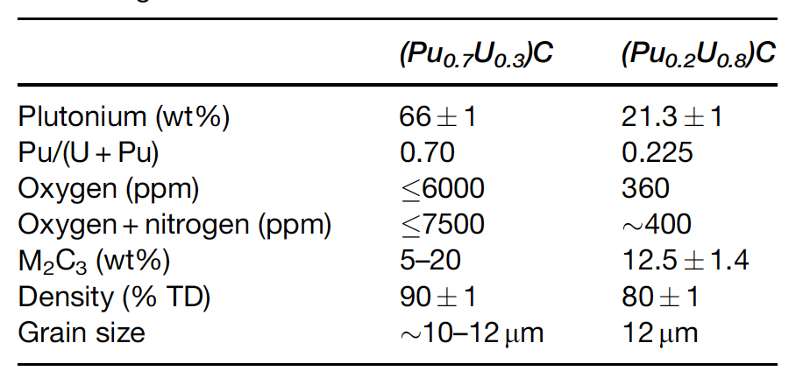
Carbide Fuel Details
A hyperstoichiometric (C/M>1, carbon to metal ratio) fuel composition is chosen so that it contains some amount of sesquicarbide M2C3 phase (M=U+Pu), which accounts for the decrease in (C/M) ratio with burnup
A sufficiently low C/M ratio may result in the formation of actinide metal phases, which may form low-melting eutectics with the cladding and limit the life of the fuel pin
FCMI can potentially exist, depending upon the operating temperature of the fuel
O and N impurities play important roles, as they act as ‘carbon equivalent’, which affect the carbon potential of the fuel
Also have high Pu and low Pu designs, which impact properties and impurity sensitivity

Slide 15
Carbide Fuel Details
Carbide fuels have higher swelling and lower fission gas release than oxide fuels
This is due to the lower fuel temperatures (higher thermal conductivity), and the microstructural evolution of fission gases
However, carbide fuels go to significantly higher burnups, leading to larger fission product inventories
Burnup limits are imposed by cladding stresses/damage due to fission gas pressure and FCMI

Slide 16
U(Pu)-C Phases
Uranium forms three compounds with carbon: UC, U2C3, and UC2, with only U2C3 being stoichiometric
UC is stable over a wide temperature and composition range
UC2 is stable in two high temperature phases
The Pu–C system has four compounds: Pu3C2, PuC1–x, Pu2C3, and PuC2
UC and PuC are face-centered cubic structures (NaCl-type)

Slide 17
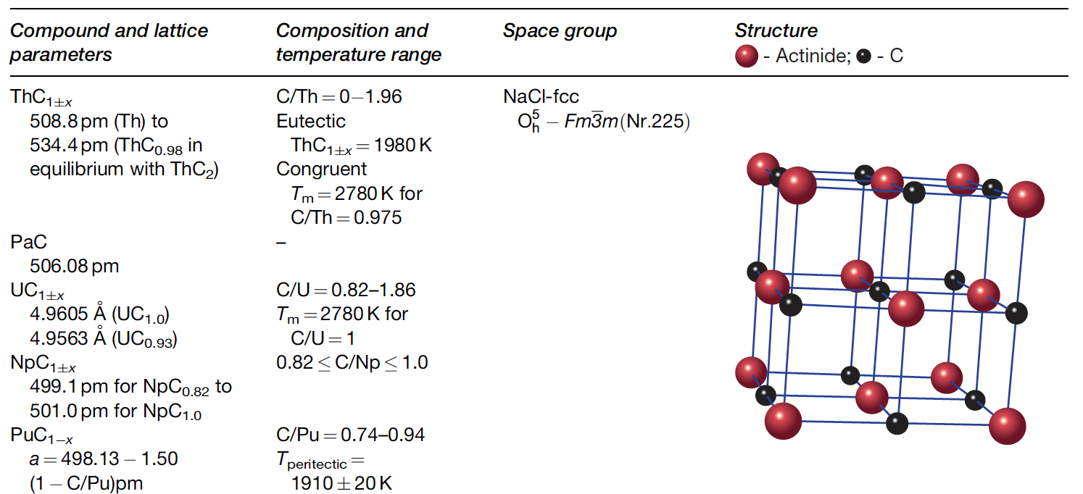
U/Pu-C Phase

Slide 18
Phase Properties
The brittleness of the monocarbides is due to alternate close-packed planes of metal and nonmetal atoms, restricting the slip and thereby hardening the crystal
Many fission products are not soluble in the monocarbide lattice due to the nature of the carbon bonding
The high density and low FP solubility of UC leads to higher swelling than UO2
The U2C3 phase has more open space in the structure, and generally has less swelling than UC
An increase in O and N impurities results in an increase of carbon activity and CO pressure of the fuel
O impurities are also known to contribute to the actinide redistribution in carbide fuels and fuel restructuring during burnup

Slide 19
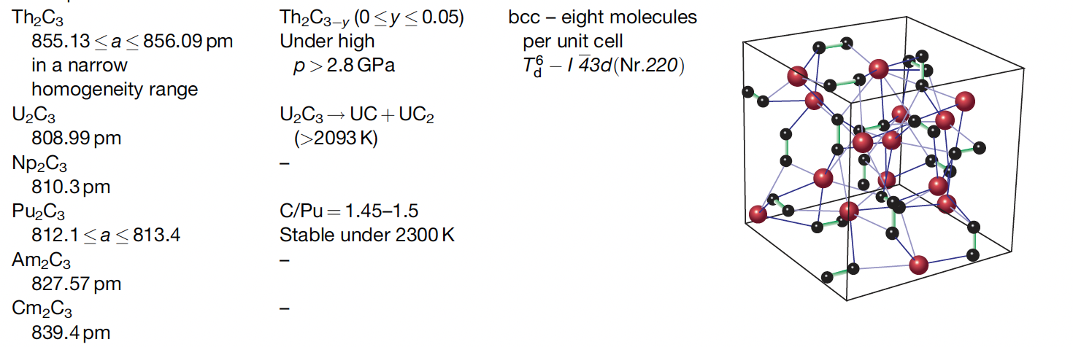
U/Pu2-C3
This structure is more complex than that of the mono- and dicarbides, and is often difficult to form
U2C3 is produced by a complex preparation procedure and decomposes into a mixture of mono- and dicarbides at high temperatures

Slide 20
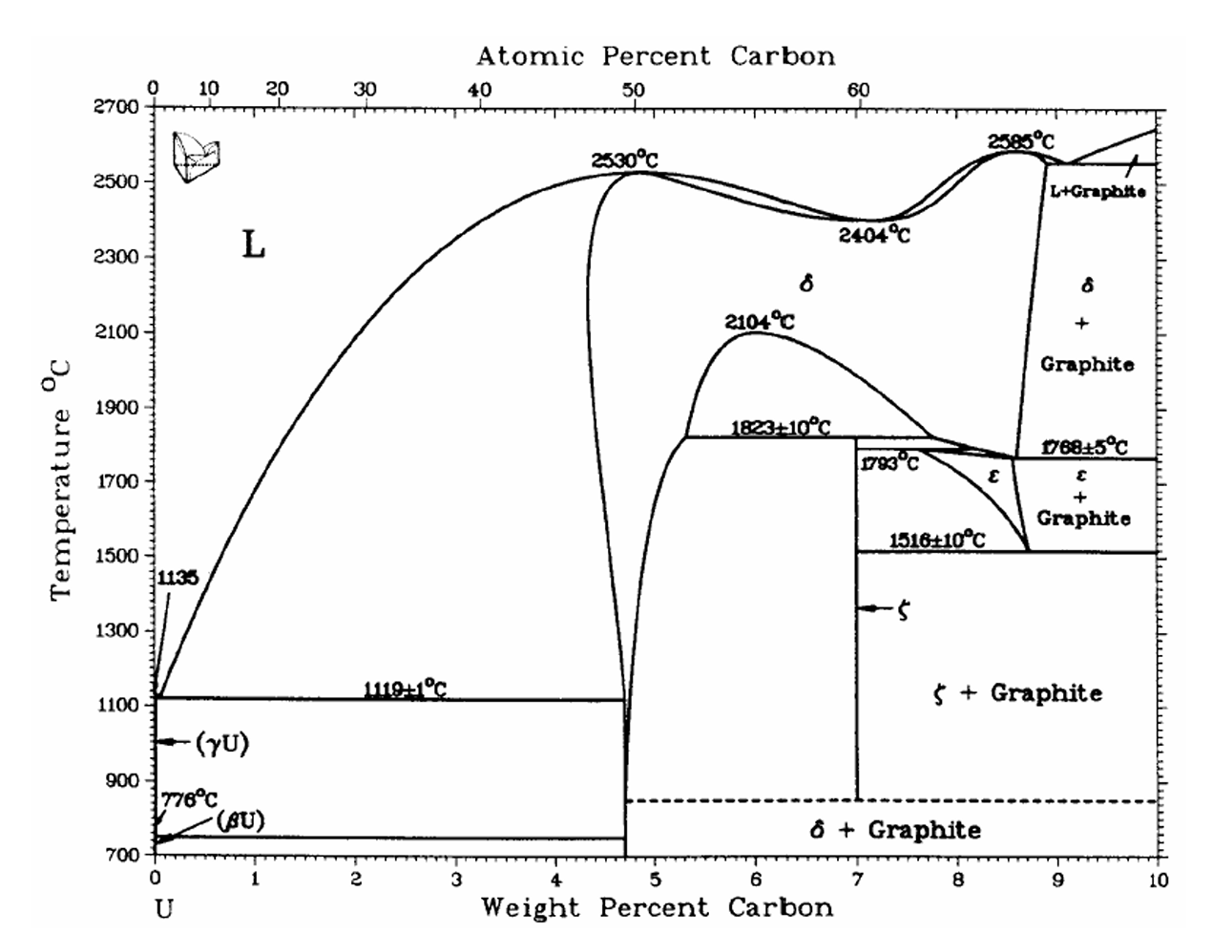
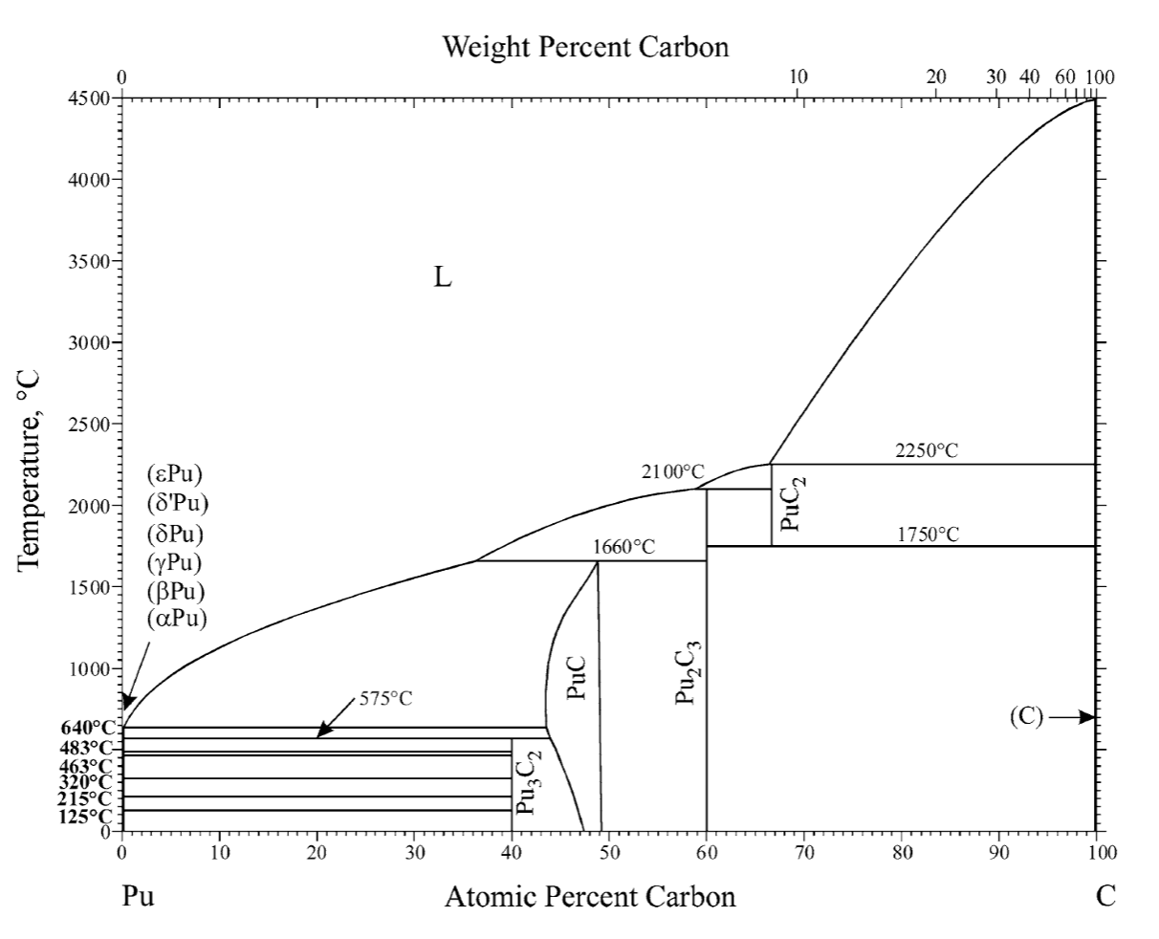
Phase Diagrams of Carbides
The differences in the UC/PuC diagrams are mainly due to (i) the presence of Pu3C2 compound, (ii) the low stability of PuC compared to UC, and (iii) the high stability of Pu2C3 compared to U2C3

Slide 21
Key Properties
The thermophysical properties that are of importance and affect the fuel performance are solidus/liquidus temperature, thermal conductivity, coefficient of thermal expansion, elastic/fracture properties, creep, and hardness at ambient and at high temperatures
The solidus/liquidus temperatures along with thermal conductivity limit the fuel operating temperature in terms of linear heating rate
Thermal conductivity varies as a function of density, porosity (shape, size, and distribution), composition, presence of a second phase, grain size, etc.
Coefficient of thermal expansion is an important design parameter, the stresses generated in the fuel and by the fuel in the cladding are partly due to the difference in the CTE between the fuel and the cladding

Slide 22
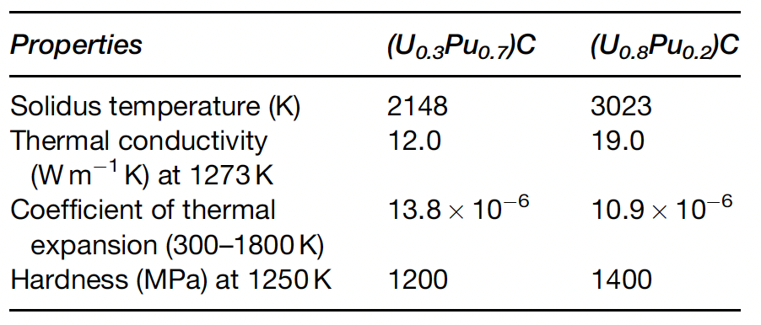
Key Properties
The elastic and fracture properties of the fuel are primarily responsible for the extent and severity of FCMI
Both thermal-induced and irradiation- induced creep of the fuel also determine the extent of FCMI
Mechanical and creep properties depend on composition, second phases, grain size, etc.
Pu lowers melting point, decreases thermal conductivity, increases expansion, and softens the fuel

Slide 23
In-pile behavior
The in-pile fuel behavior depends to a large extent on the fuel operating temperature, which in turn depends on the type of pin or bond concept, namely, He-bonded fuel or Na-bonded fuel
A large number of mixed carbide fuels have been irradiated in the US, Europe, Russia, India, and Japan
The performance analysis of the mixed carbide fuel can be best understood based on their burnup period, the structural changes occurring during the burnup, and subsequently the swelling of the pin

Slide 24
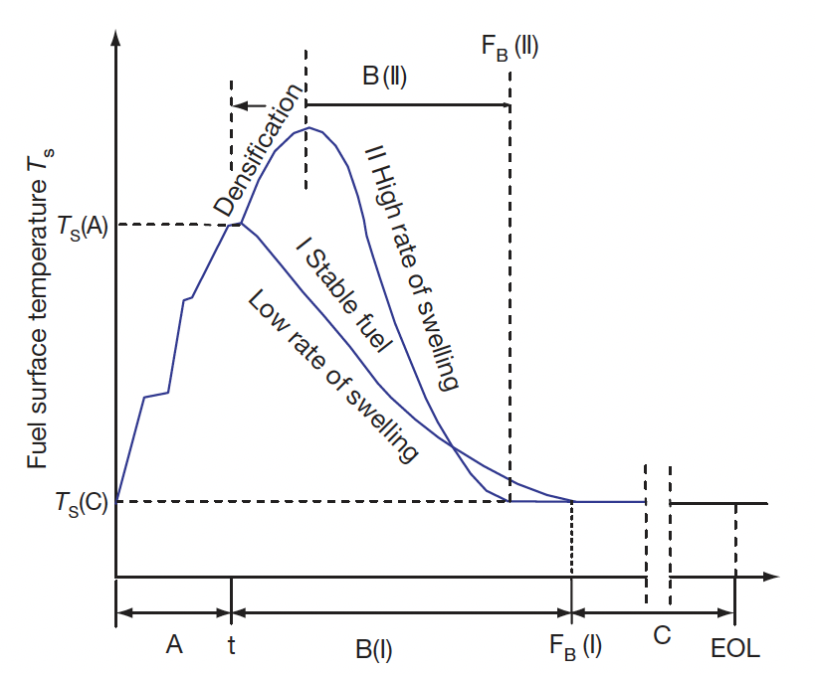
Burnup Stages
Stage A: At the BOL, the fuel undergoes cracking, which results in the movement of the fragmented fuel toward the cladding surface
The fuel–clad gap partly reduces but does not close
Fuel sees a dramatic increase in temperature due to cracking
Stage A lasts for a few days

Slide 25
Burnup Stages
Stage B: Fuel undergoes unrestrained free swelling, crack healing, or resintering
Resintering/densification occurs for thermally unstable or low density fuels, which causes an initial increase in gap size resulting in the rise in the fuel surface temperature
In stage B, free swelling occurs and crack healing starts, which results in the relocation of fuel fragments further from the center of the fuel to the periphery
Swelling causes fuel–clad gap closure, increase in heat transfer coefficient, and decrease in fuel surface temperature
Surface roughness of fuel and cladding limits complete gap closure
FCMI begins due to the swelling of the fuel
Stage B ends after a burnup of approximately 3 at.%

Slide 26
Burnup Stages
Stage C
This stage starts after fuel–clad gap closure when a steady minimum surface temperature is reached, and it continues until the end of fuel life
For carbide fuel, this could be up to 15 at.%
At this stage, more homogeneous fuel–clad interaction starts

Slide 27
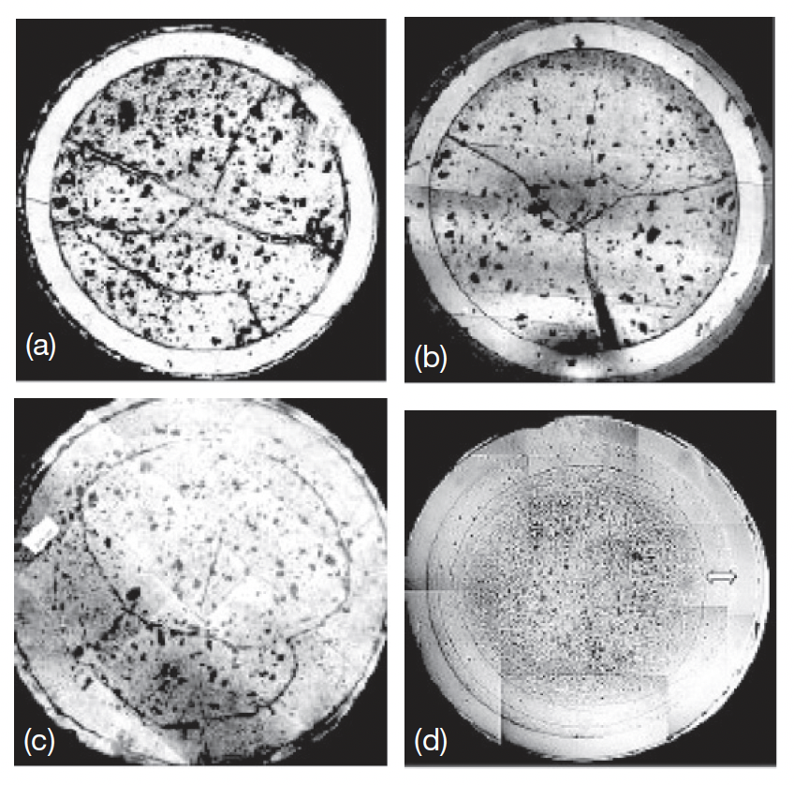
Evolution with Burnup
Carbide fuel containing 70% and 55% PuC was used as the driver fuel for FBTR
PIE at burnups of 2.5, 5, 10, and 15.5 at.% shows the evolution of the pin
After 10 at.% burnup, the gaps had closed at the center of the fuel column
Circumferential cracks due to thermal stresses formed, and a discrete zone free from any porosity is observed near the outer region

Slide 28
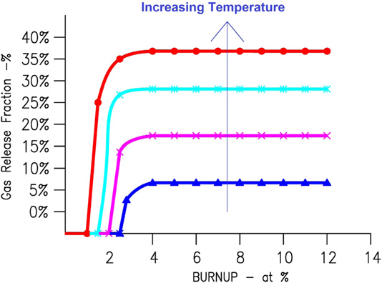
Fission Gas Release
FGR in carbide fuel pins is lower than oxide fuel pins, mainly due to lower temperatures
Release rates from carbide are <1% at temperatures below 900 C but rise to about 5%–10% with temperature rising to 1200 C
Above 1200 C, gas release is associated with bubble growth and interlinkage at grain boundaries, as in oxide fuels
Low density fuel releases more FG than high density, due to additional porosity
Off-stoichiometry also promotes porosity, and thus increases FGR

Slide 29
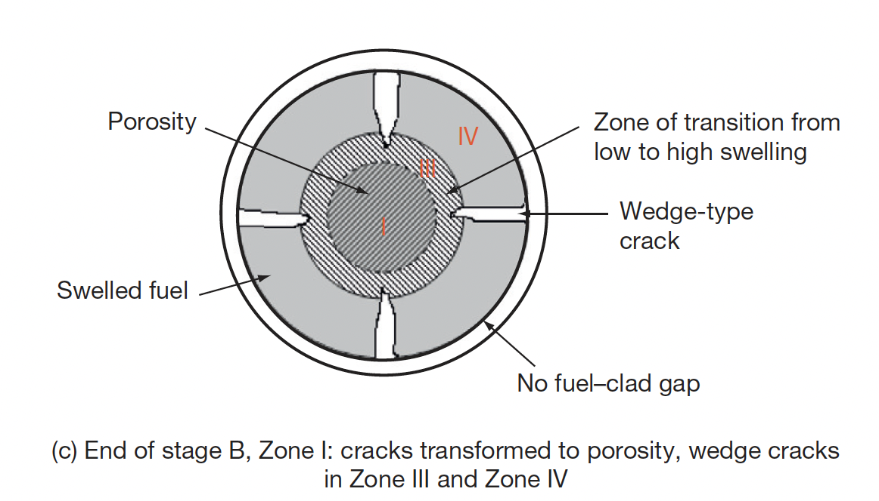
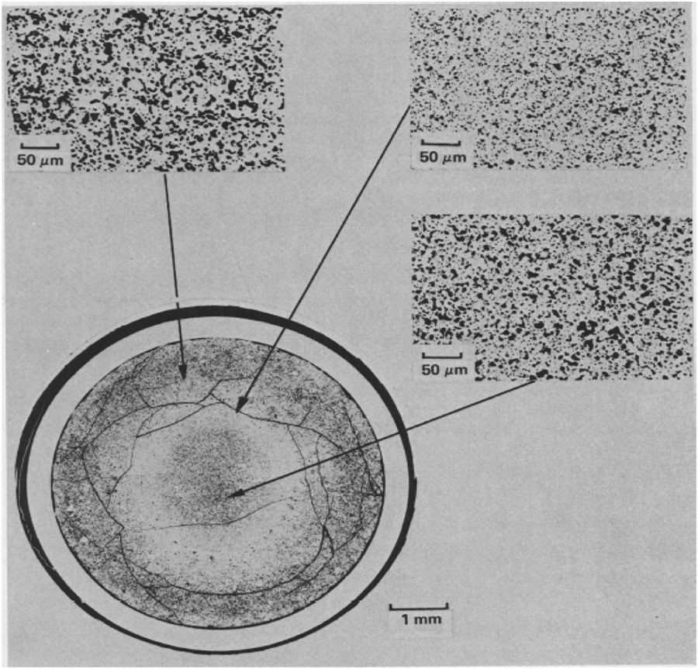
Fuel Restructuring
The cross section can be divided into four structural zones, become well defined when the fuel sees a burnup of 1.3 at.%.
Zone 1 is the porous fuel at the center having high temperature and helps in the release of fission gases
Zone 3 contributes to high microscopic swelling
Zone-IV is the coolest zone of the fuel cross section, which is next to the fuel cladding
Zone 2 is an intermediate zone that only exists at very high heating rate (>100 kW/m)

Slide 30
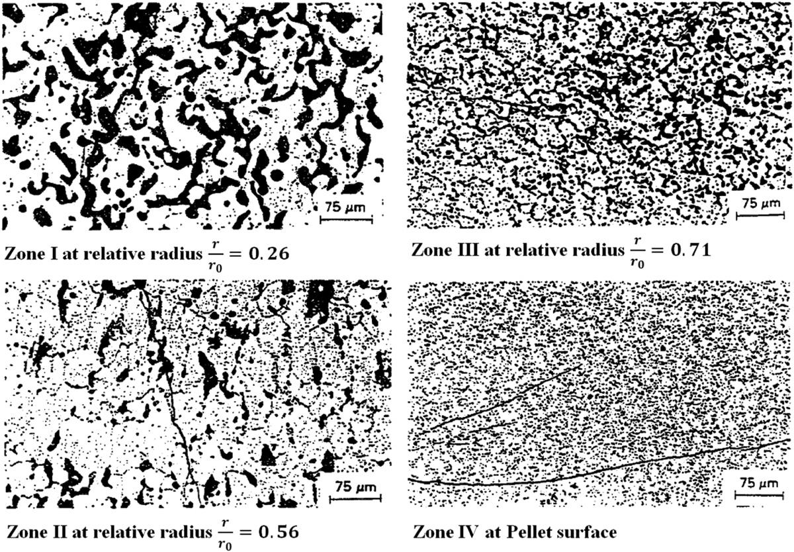
Fuel Restructuring
Zone 1 has large bubbles, interconnected porosity
Zone 2 exhibits grain growth parallel to the temperature gradient, similar to columnar grains in MOX fuel
Zone 3 has coaxial grain growth and developed porosity
Zone 4 typically has a stable grain size and near as-fabricated porosity
Zone 2 does not always form, expected to form at higher temperatures
At low LHR (<50 kW/m) no restructuring is observed

Slide 31

Fuel Creep
The source of stresses in the fuel under irradiation is the pressure generated by fission gases produced within the fuel
After the fuel–clad gap closure, free swelling is restrained, and a back stress is generated by the cladding on the fuel
Unlike close-packed metals, deformation of carbide requires much higher stresses because of the strong covalent bonding existing between the metal atom and the carbon atom
Two types of creep deformation are operative in the fuel: temperature-dependent thermal creep and irradiation creep
Thermal creep has been shown to start at 1000C and dominate over radiation-induced creep
The steady-state creep curve has been determined and is a function of stress, temperature, composition, grain size, and impurity content in the fuel

Slide 32
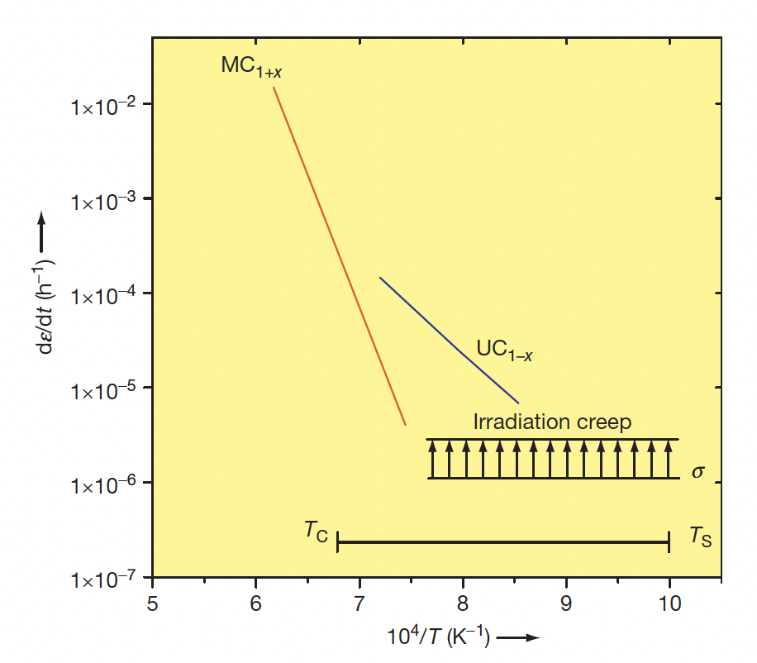
Fuel Creep
Steady-state creep data of UC_{1-x} and MC_{1+x} at a stress of 20 MPa
Substantial creep only exists for a limited part of the fuel, and thus most of the fuel acts as a brittle material
Irradiation-induced creep is independent of temperature, but increases with fluence
Additional porosity or second phases will change this data
No data on creep of high-Pu mixed carbide or Pu-C fuel

